Slide 1
A 50-minutes trip
Plan:
ILVR: Conditioning Method for Denoising Diffusion Probabilistic Models
Palette: Image-to-Image Diffusion Models

Slide 2
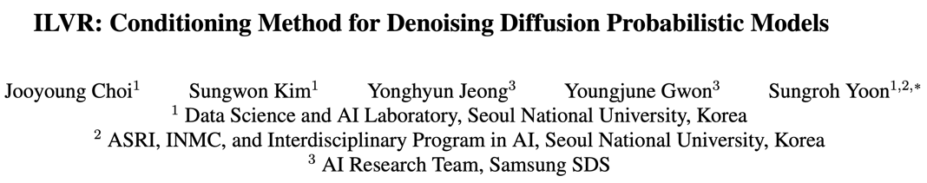
Aug 21
ILVR for “Iterative Latent Variable Refinement”

Slide 3
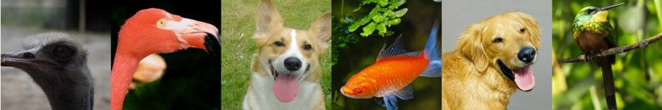
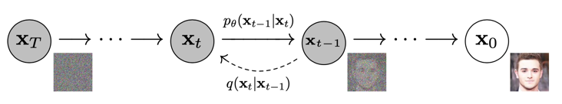


Motivation
So diffusion models can generate images really well:
Diffusion Models Beat GANs on Image Synthesis, May 21
But those are uncoditional by theire nature:
Even with the same initial state!

Slide 4
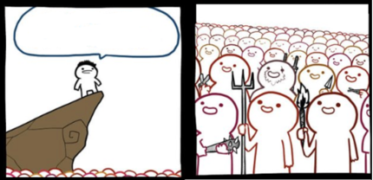
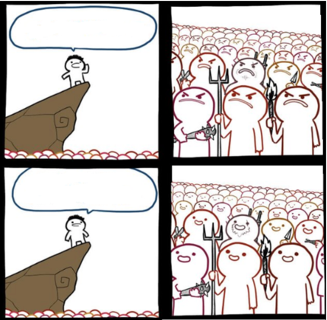
Diffusion Models Beat GANs on Image Synthesis
May 21
but it’s UNCONDITIONAL
ILVR
Aug 21

Slide 5
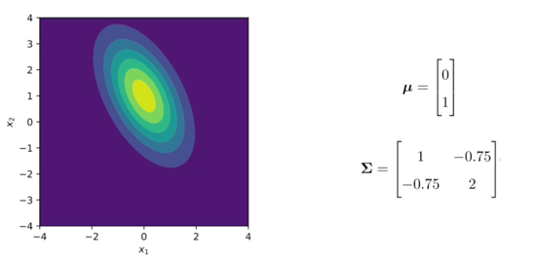
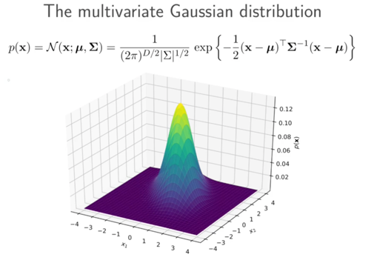
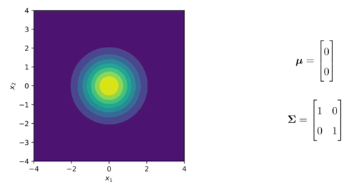
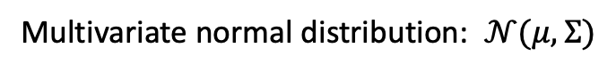
Cool but… HOW?
Preliminaries
Multivariate normal distribution: $𝒩(μ,Σ)$

Slide 6
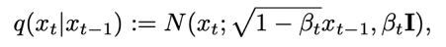
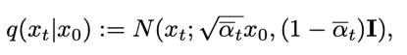
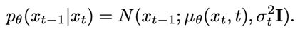
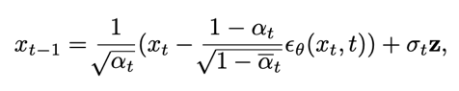
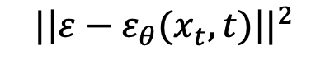
Cool but… HOW?
Preliminaries
Denoising Diffusion Probabilistic Models (DDPM):
Diffusion Models learns a Markov Chain that gradually converts $x \sim 𝒩(0, I)$into $y$ from the data distribution
Forward process:
Generative process:
Objective loss:
$${|\left|ε−ε_{θ}(x_{t}, t)\right||}^{2}$$

Slide 7
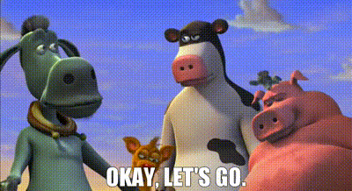
Cool but… HOW?

Slide 8
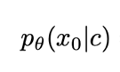
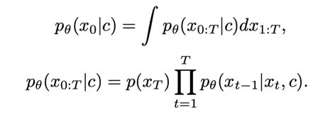
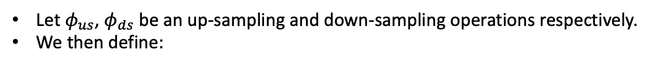
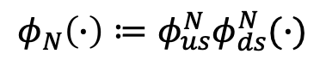
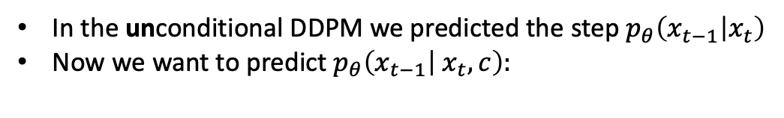
Cool but… HOW?
Now we want to sample images from the conditiontal distribution:
In the unconditional DDPM we predicted the step $p_{θ}\left(x_{t−1} | x_{t}\right)$
Now we want to predict $p_{θ}\left(x_{t−1} | x_{t}, c\right):$
Let $φ_{us}$, $φ_{ds}$be an up-sampling and down-sampling operations respectively.
We then define:
$$φ_{N}\left(∙\right)≔φ_{us}^{N}φ_{ds}^{N}(∙)$$
Condiction $c$ want to ensure that $φ_{N}(X_{0}) =φ_{N}(y)$

Slide 9
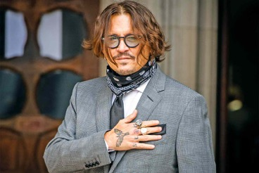

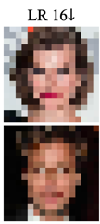
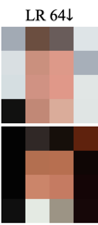


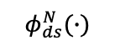
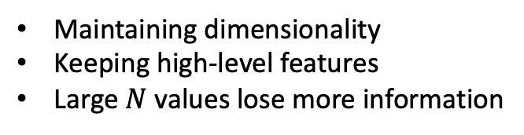
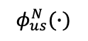

Cool but… HOW?
$φ_{N}\left(∙\right)≔φ_{us}^{N}φ_{ds}^{N}(∙)$ , illustrations:
orig
$$φ_{ds}^{N}(∙)$$
$$φ_{us}^{N}(∙)$$
Maintaining dimensionality
Keeping high-level features
Large $N$ values lose more information

Slide 10
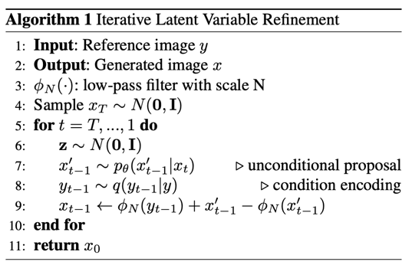
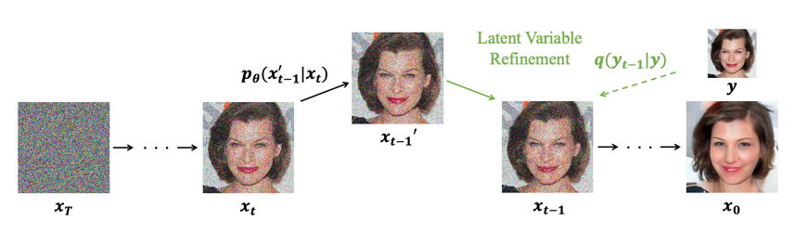
Cool but… HOW?

Slide 11
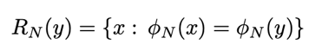
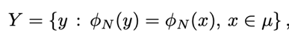
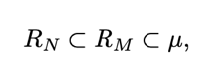
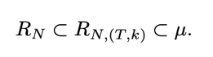
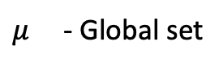
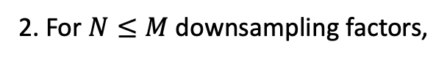
One more thing
Reference selection and user controllability
Goal: To extend the method to various applications
Let's define some stuff and explore properties:
$μ$- Global set
Properties:
1. Reference image can be any image selected from
2. For $N≤M$downsampling factors,
3. Limiting the range of the conditioning step derives:

Slide 12
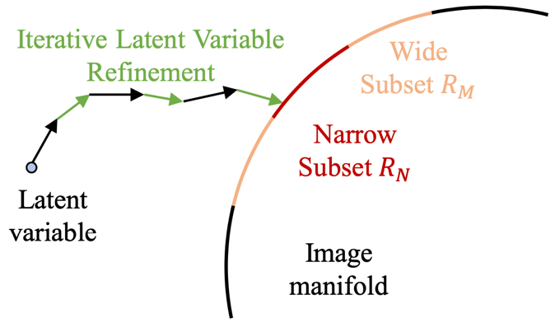
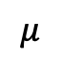
One more thing
Reference selection and user controllability
Goal: To extend the method to various applications
$$μ$$
- Global set

Slide 13

Let’s wrap it up

Slide 14
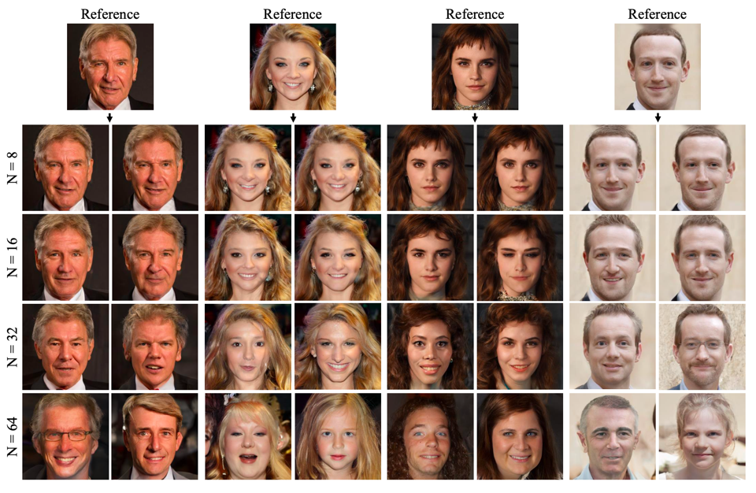
Results

Slide 15
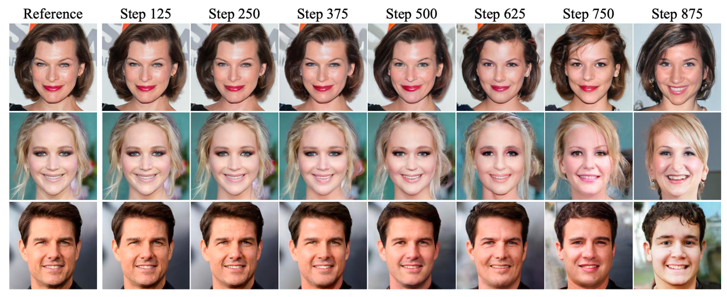
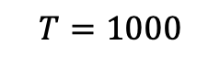
Results
$$T=1000$$

Slide 16
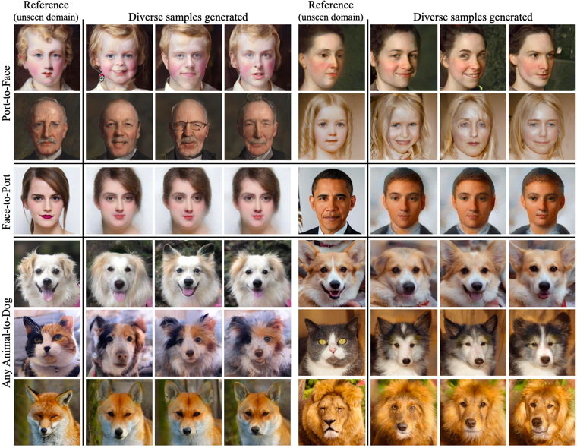
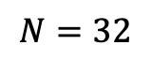
Results
Multi-Domain Image Translation
$$N=32$$

Slide 17
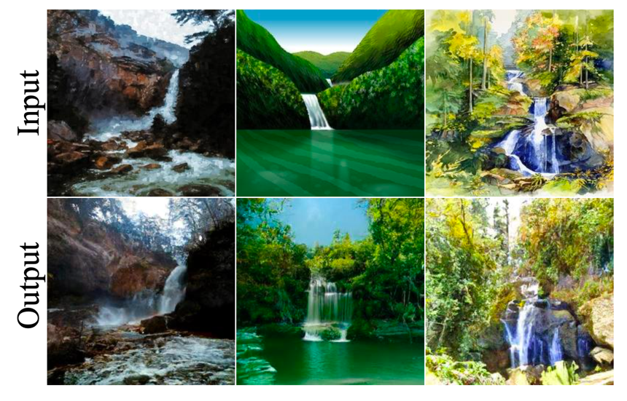
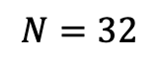
Results
Multi-Domain Image Translation
Paint-to-Image
$$N=32$$

Slide 18
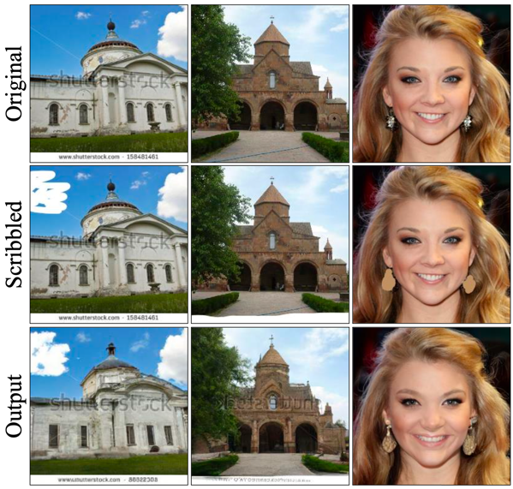
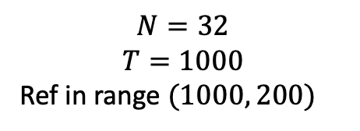
Results
Editing with Scribbles
$$N=32$$
$$T=1000$$
Ref in range $(1000, 200)$

Slide 19
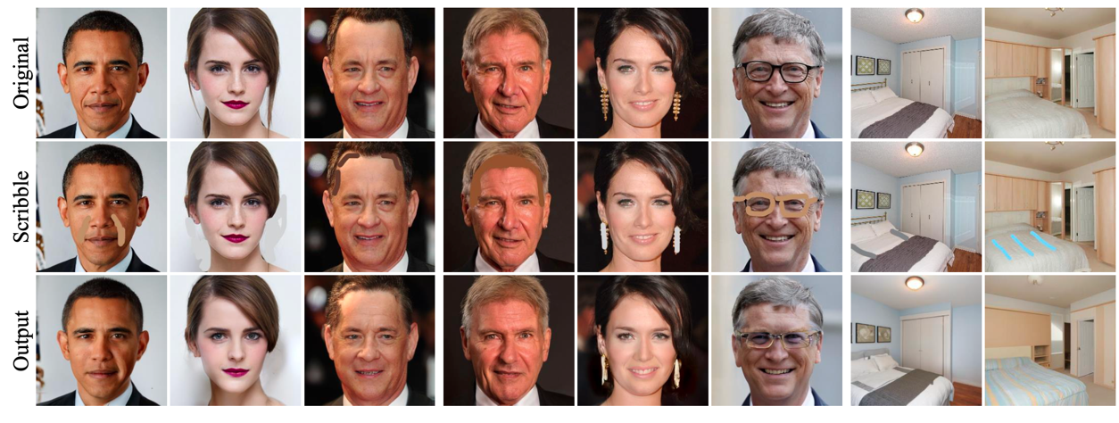
Results
Editing with Scribbles

Slide 20
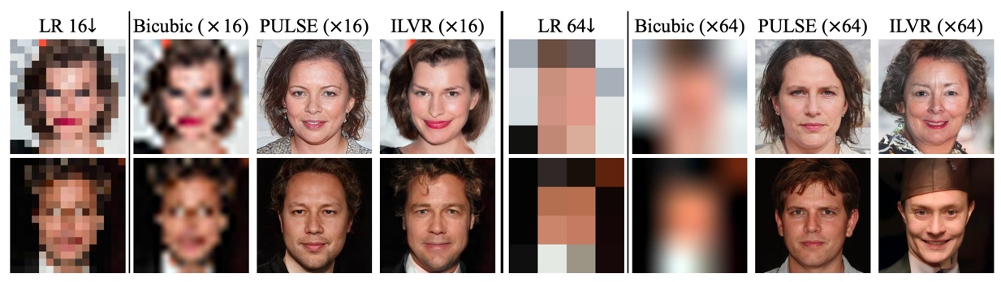
Results
Comparison on generation quality

Slide 21
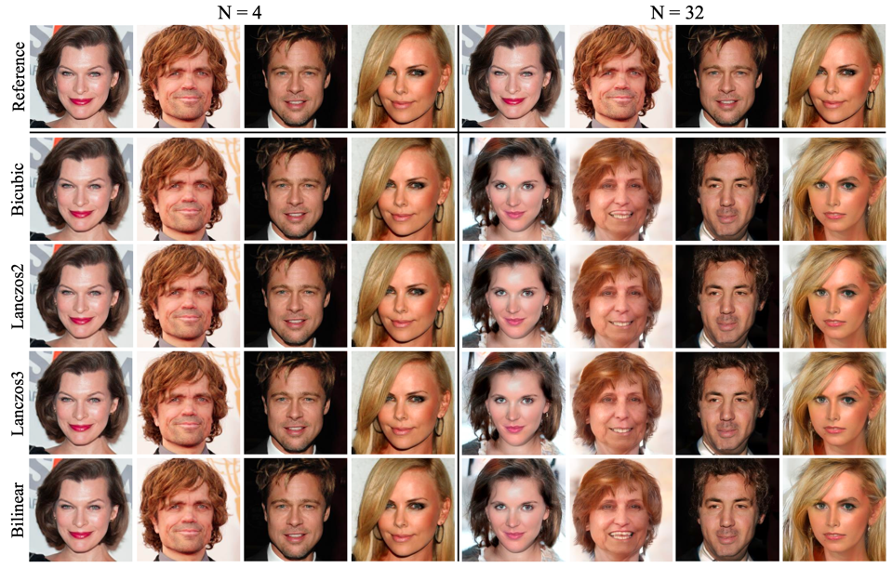
Results

Slide 22

Questions ?

Slide 23
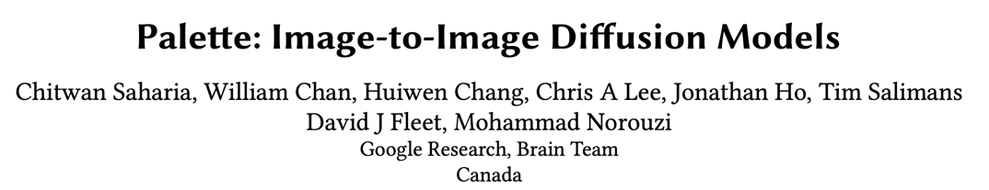
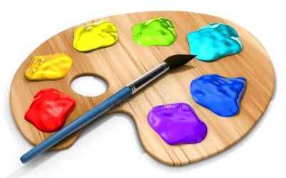

Slide 24

Motivation
Tasks in computer vision are varied:

Slide 25
Motivation
Tasks in computer vision are varied:
Cool Tasks | Diffusion Models (DDPMs) | GANs
Unconditional Image-Generation
Conditional Image-Generation
Colorization
Inpainting
Uncropping (Image Extension)
JPEG restoration
✅
✅
✅
✅
❌
✅
❌
✅
❌
✅
❌
✅

Slide 26

Motivation

Slide 27

Preliminaries
U-net + Pix2Pix (Reminder):

Slide 28


Preliminaries
U-net + Pix2Pix (Reminder):
U-net

Slide 29

Conditioning
In this paper the authors are using a different conditioning technique:
Image Super-Resolution via Iterative Refinement (Google Research, Brain Team, June 21)

Slide 30
Metrics
Inception Score (IS): (higher is better)
Uses an InceptionV3 pre-trained model. IS is maximized when:
The model confidently predicts a single label for each image.
The predictions are evenly distributed across all labels (the generative model is “diverse”)
Fréchet Inception Distance (FID): (lower is better)
Uses InceptionV3 pre-trained model to extract features and compares distributions with the GT.
Classification Accuracy (CA): (higher is better)
perform this inference by training an image classifier using only synthetic data and using the classifier
to predict labels on real data
Perceptual Distance (PD) (lower is better)
Euclidean distance in the feature space of a pre-trained InceptionV1 model.

Slide 31
Colorization
“ transforms an input grayscale image to a plausible color image"
Uses RGB color space to maintain generality across tasks
Training:
randomly select the largest square crop from the image and resize it to 256×256.

Slide 32

Colorization
Results

Slide 33


Colorization
Evaluation

Slide 34
Inpainting
“ fills in user-specified masked regions of an image with realistic content "
Fills the masked regions with standard Gaussian noise
Training:
Use a combination of free-form and rectangular masks
Mask coverage between 10% to 40%
To speed up training, the loss only cosiders the masked pixels

Slide 35

Inpainting
Results

Slide 36


Inpainting
Results

Slide 37

Inpainting
Evaluation

Slide 38
Uncropping
“extends an input image along one or more directions to enlarge the image "
Fills the masked region with standard Gaussian noise
Training:
Along all four directions or just one direction
Mask region is 50%
To speed up training, the loss only cosiders the masked pixels

Slide 39

Uncropping
Results

Slide 40

Uncropping
Results

Slide 41


Uncropping
Evaluation

Slide 42

Uncropping
Evaluation

Slide 43

Uncropping
A nice application - Panorama

Slide 44

Uncropping
A nice application - Panorama

Slide 45


JPEG restoration
“corrects for JPEG compression artifacts, restoring plausible image detail "
Fills the masked regions with standard Gaussian noise
Training:
Various quality factors (QF) in range $(5, 30)$
Authors use exponential distribution to sample the QF: $ℙ\left(QF=q\right)∝e^{− \frac{q}{10}}$

Slide 46

JPEG restoration
Results

Slide 47

JPEG restoration
Results

Slide 48

JPEG restoration
Evaluation

Slide 49
Multi-task Learning
“approach to learning a single model for multiple image-to-image tasks”

Slide 50

Multi-task Learning
Results

Slide 51

Multi-task Learning
Results

Slide 52

Multi-task Learning
Evaluation

Slide 53

Sample Diversity

Slide 54
General Notes
The authors didn’t find over-fitting to be an issue
The authors didn’t apply any task specific hyper-parameters tuning / architectural modifications.

Slide 55
Limitations
Large number of finement step (1K in Palette) resulting slow inference compared to GAN based models.
Implicit biases (general problem for generative models)

Slide 56
Questions ?

Slide 57


